Slide 1

Carlos Chavez Paura
Jul. 2022
Introduction to Large-Scale Data Analytics
Ref. Robert Ilijason, 2020. "Beginning Apache Spark Using Azure Databricks," Springer Books, Springer, number 978-1-4842-5781-4, August.

Slide 2

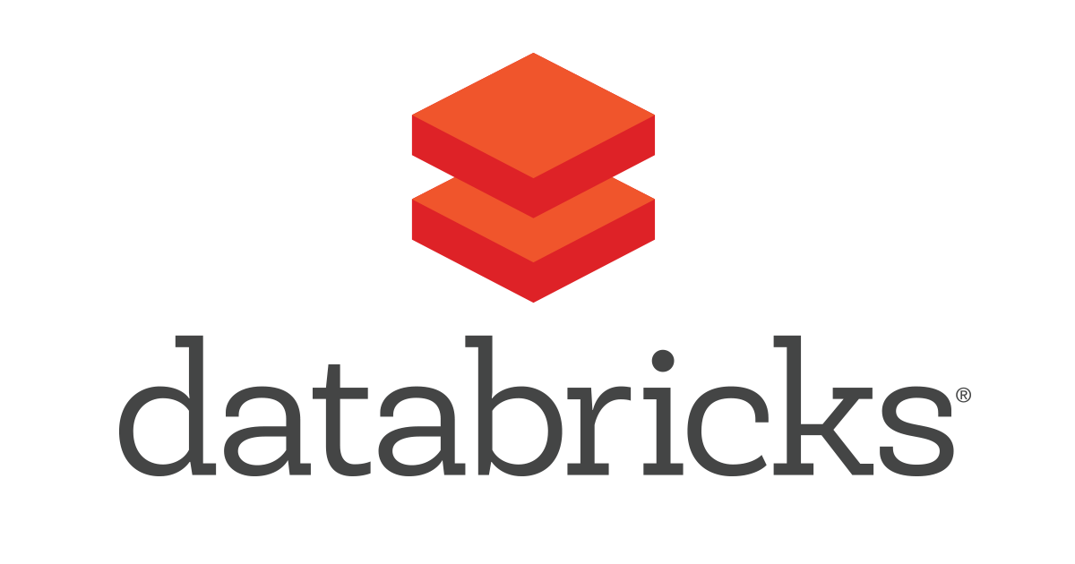
Introduction to Large-Scale Data Analytics

Slide 3
Analytics, the Hype
Not always groundbreaking
Cyborgs will not delivery our groceries…soon
Cloud power can be somewhat overhyped
Analytics is frequently useful
Cheaper items and easy deliveries
OSS (Open Source Software) are the best tools

Slide 4
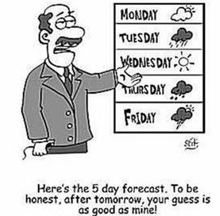
Analytics, the Reality
A lot of business analytics still on Excel on laptops
Your insurance, Netflix recommendations, Facebook feed, Goodreads suggestions, Google maps, Walmart basket suggestions, etc…..are based on analytics
The easiest can be the hardest
Make guesses with higher accuracy

Slide 5

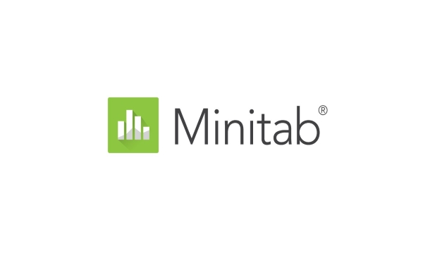
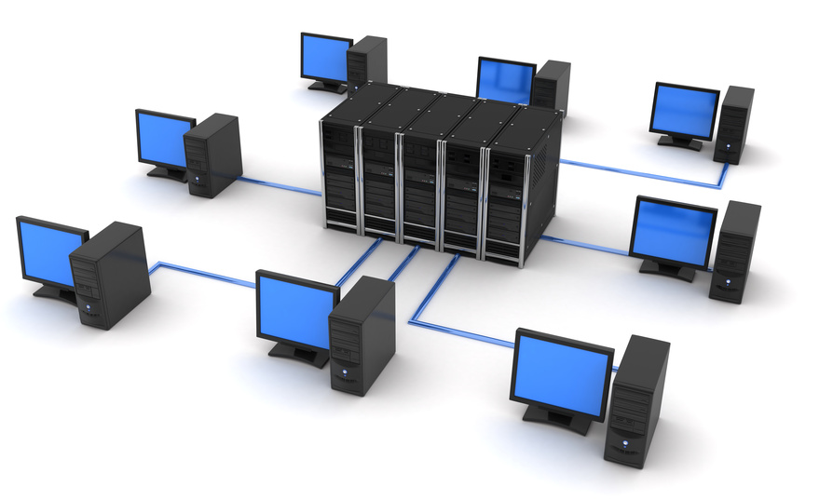
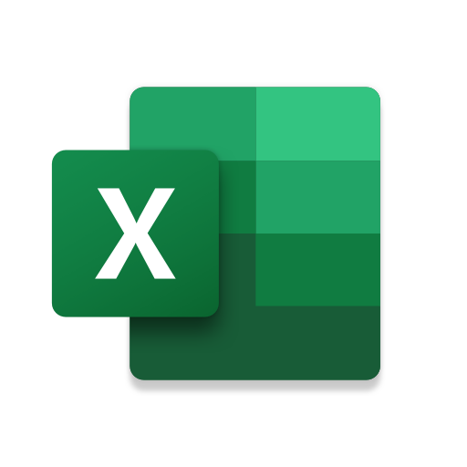


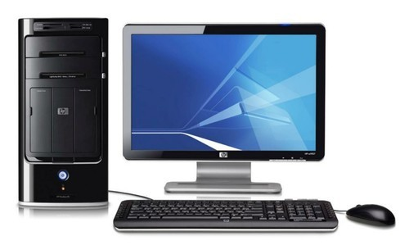
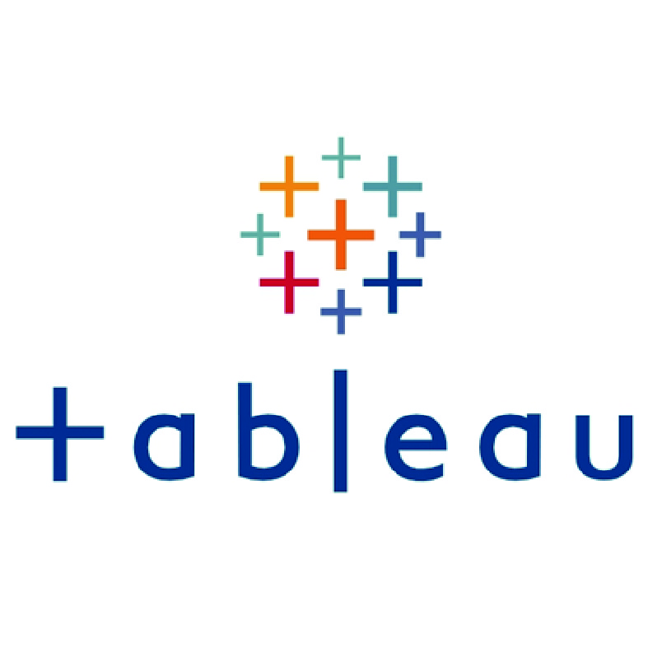
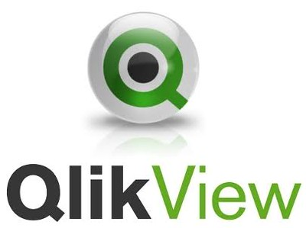
Large-Scale Analytics for Fun and Profit
+
Data Centers
Data: Deluge of data
Software: Access to great tools
Cloud: Cheap processing power

Slide 6
Data: What is Big Data?
Data that you can’t handle without spreading the processing to many machines.

Slide 7

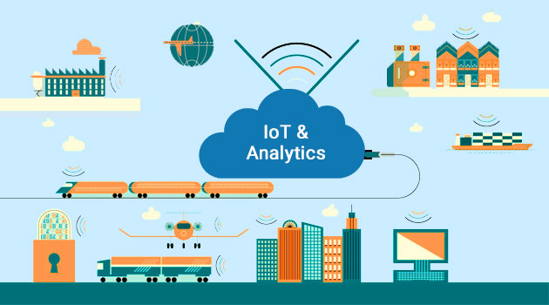
Data: Fueling Analytics
Customer-facing like clickstream analytics
IoT (car industry 22B sensors /year)

Slide 8


Data: How Fast you Need the Data?
Stream
Bulk
(flow with minimal lag and process in bulk)

Slide 9




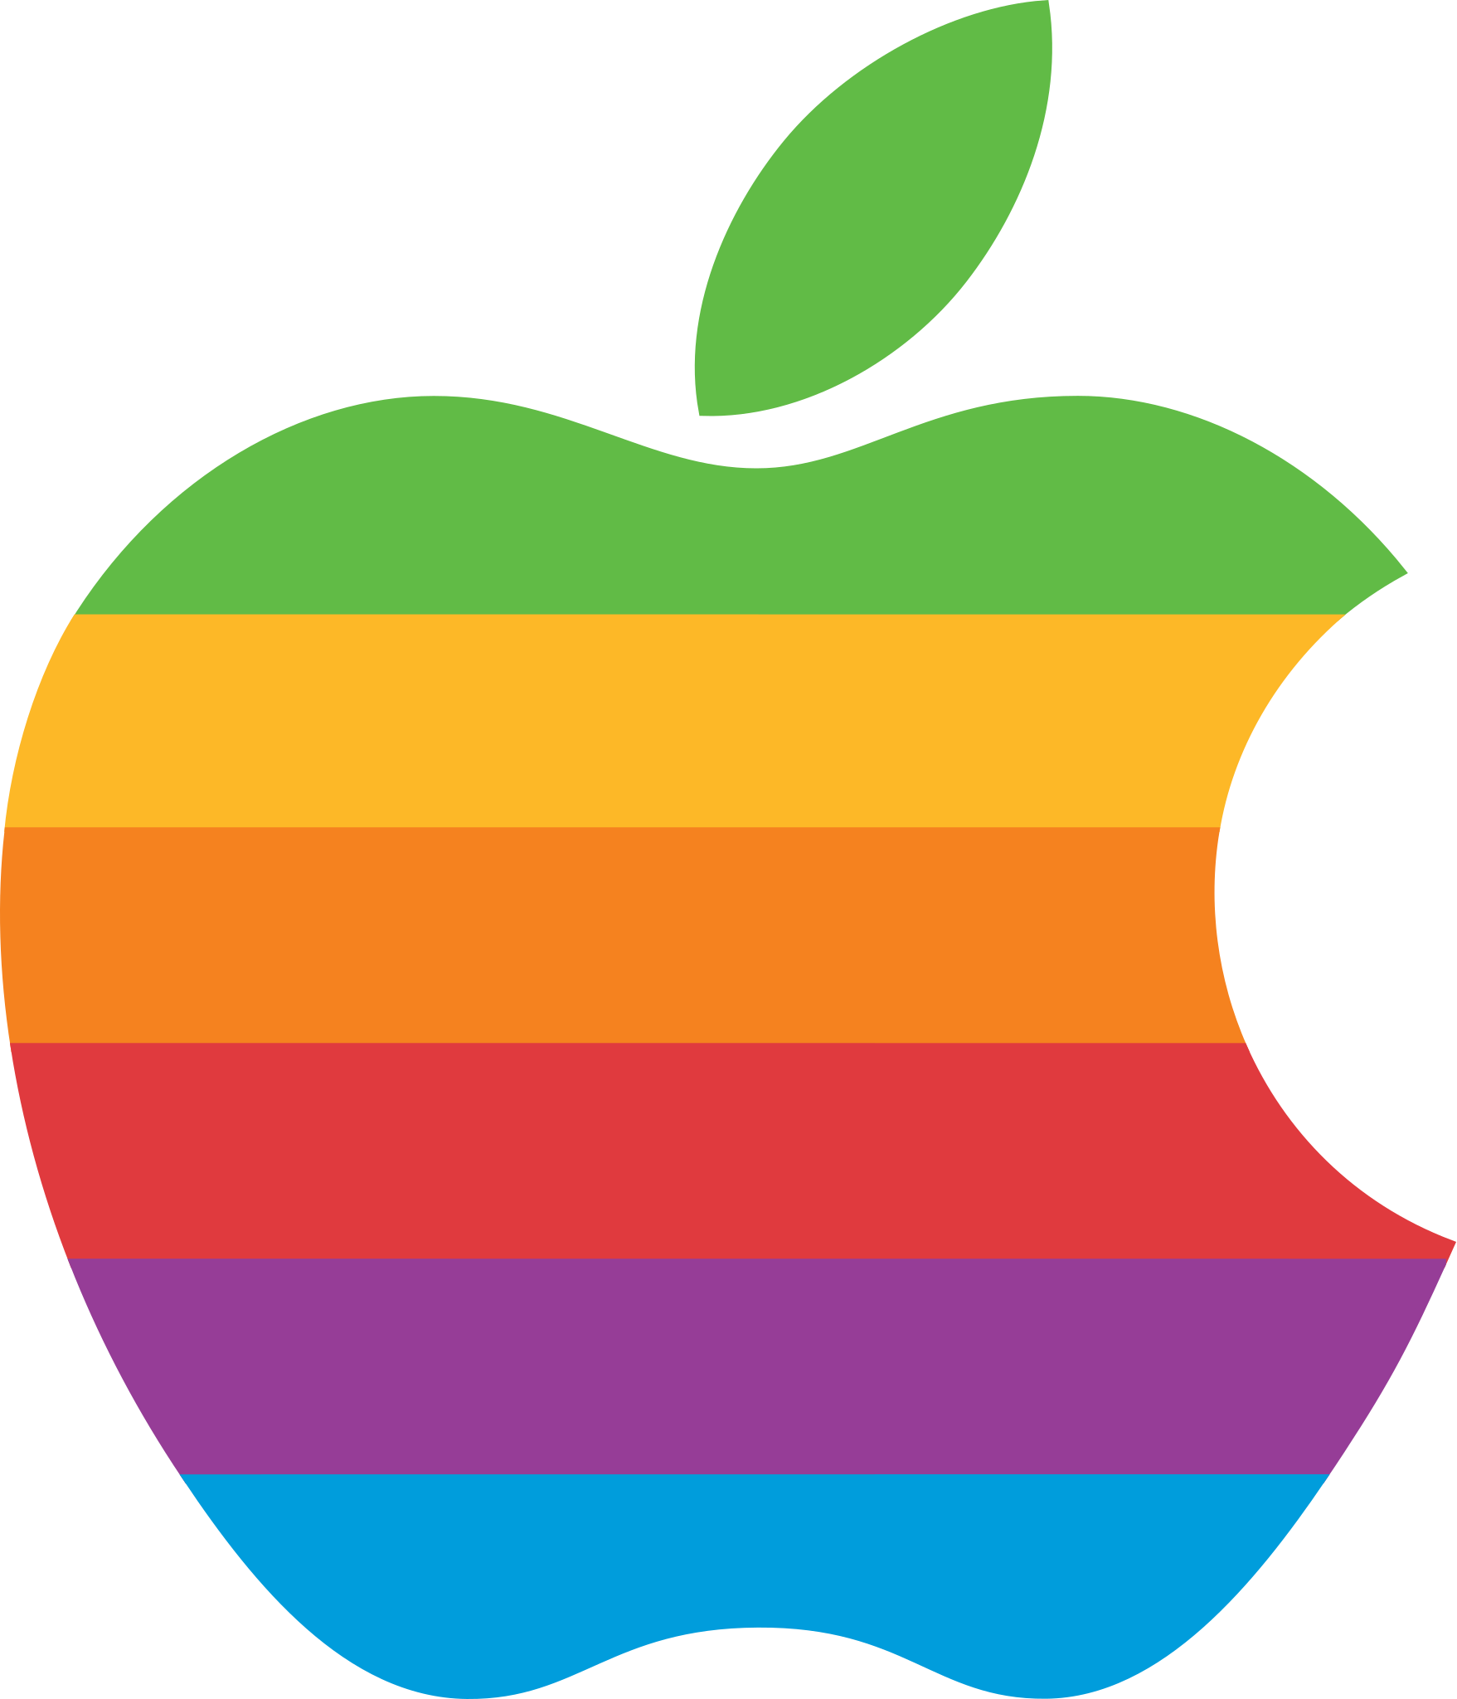




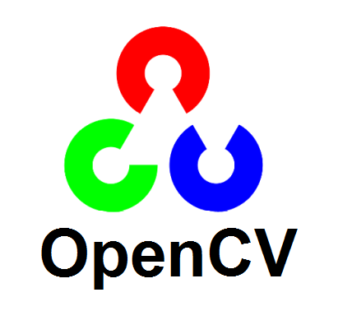

Software: Free as in Speech. And Beer!
Not only free…but the best
web server software…
languages…
thousands of packages…

Slide 10

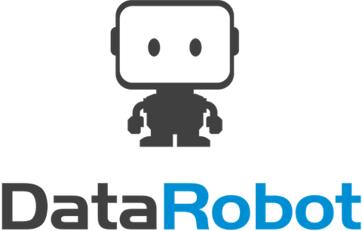

Software: Software as a Service (SaaS)

Slide 11
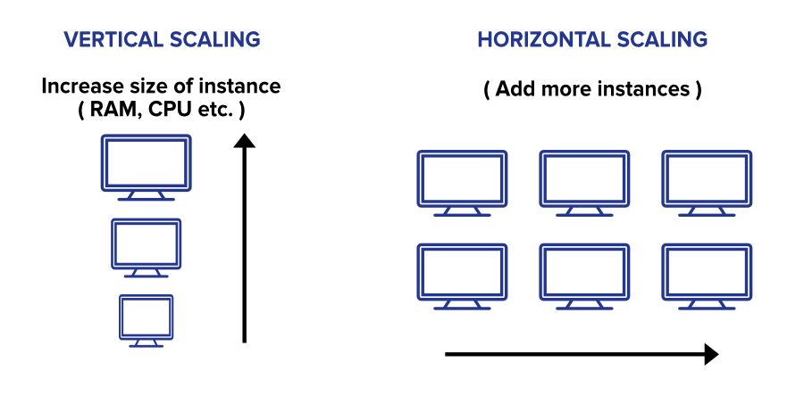
Vertical Scaling vs Horizontal Scaling

Slide 12

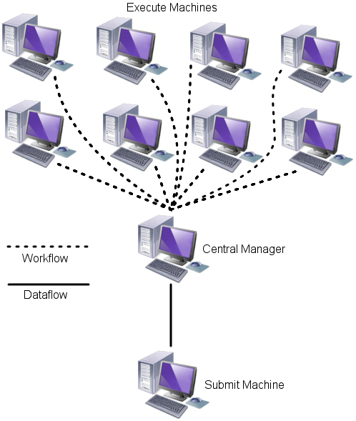


Distributed Computing
You need code that can run in parallel…
You need to get this expensive hardware…or not?

Slide 13
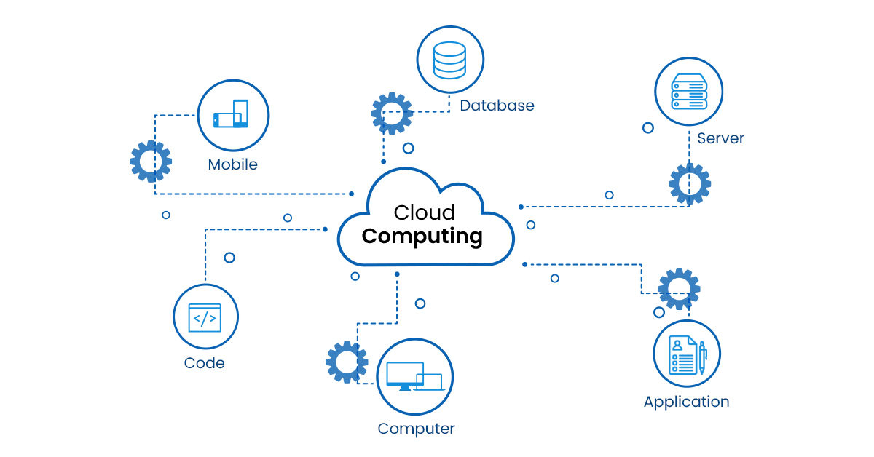
Cloud Computing
You can buy what you need when you need it…just like electricity.
You don’t own it…but you have access to near infinite amount of processing power.

Slide 14
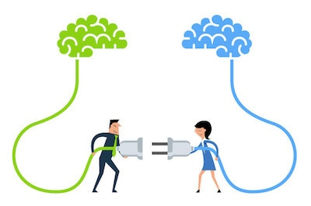
Infrastructure
Distributed Computing
Cloud Computing
Infrastructure
It is very complicated to set up everything from scratch…

Slide 15

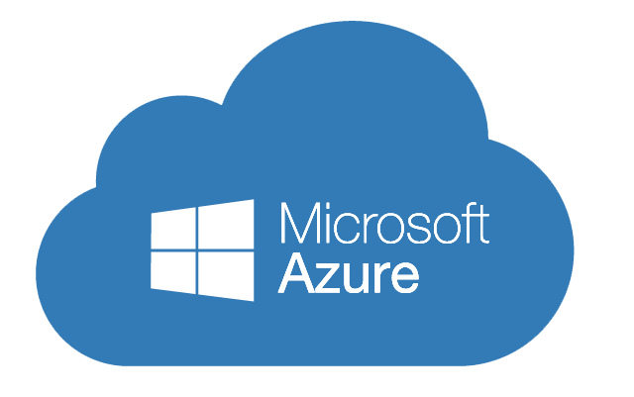
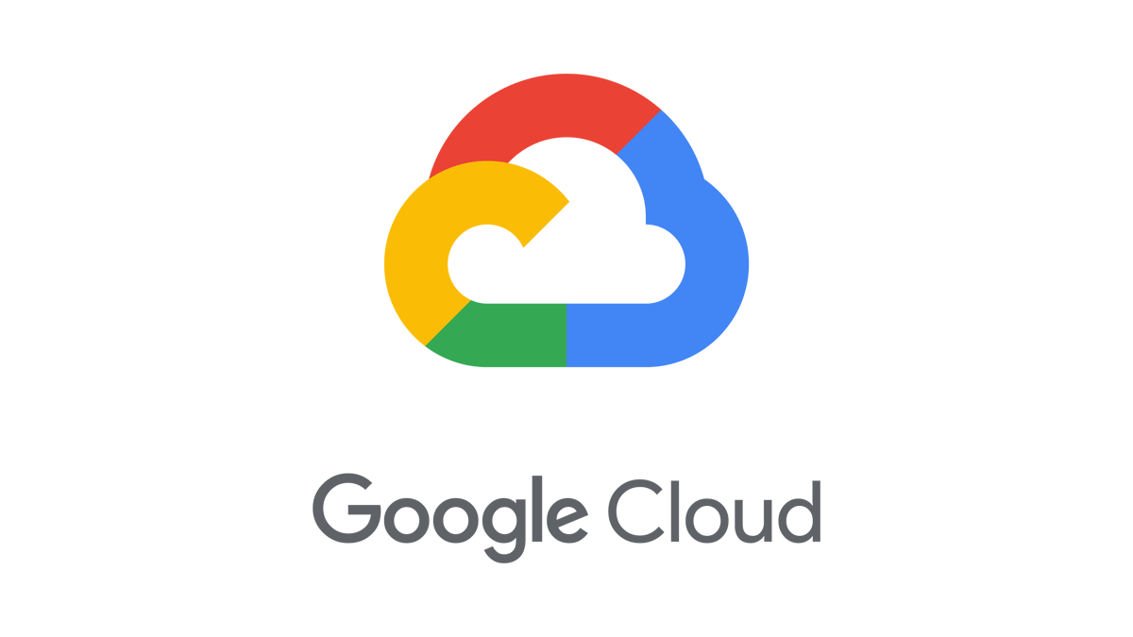

Databricks
Distributed
Computing
Cloud
Computing
Power of Apache Spark in the cloud
Infinite storage space

Slide 16
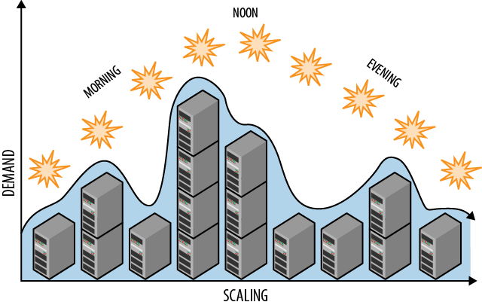
Auto-Scalable Clusters

Slide 17


How to Analyze Data?
Context:
What are you trying to achieve?
What stakeholders are interested in the problem?
Need:
What the project will bring to the table?
What will you be able to do if you solve this?
Vision:
What the result will look like?
You can mock it up
Outcome:
How the result will be used? By whom?
Who will own the resulting solution?

Slide 18
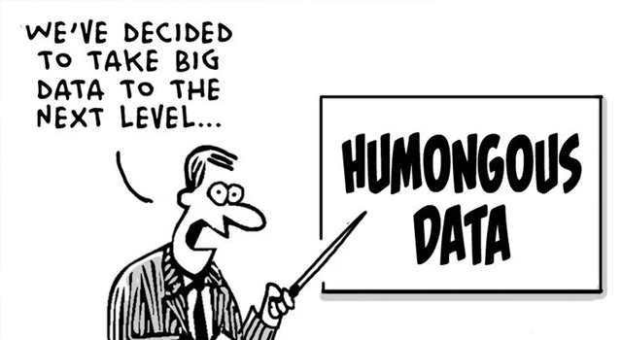

How to Get Data?
What if you don’t have it but need to get it?
When it comes to data…
the more, the better…in most cases

Slide 19





Large-Scale Examples
…analytics in real time for all purchases being made using their cards. The algorithm is looking for patterns that are similar to earlier fraudulent ones. If it seems fishy, the purchase is declined, and the cardholder informed…
…predict if a truck is about to fail. Instead of the driver being stranded, he’s early advised to drive to a service station and have the problem fixed before it happens…
In the 2010s, personal data belonging to millions of Facebook users was collected without their consent by British consulting firm Cambridge Analytica, predominantly to be used for political advertising.
…can’t hide that baby bump from Target…

Slide 20
Carlos Chavez Paura
Jul. 2022
Spark and Databricks
Ref. Robert Ilijason, 2020. "Beginning Apache Spark Using Azure Databricks," Springer Books, Springer, number 978-1-4842-5781-4, August.

Slide 21
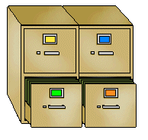
Spark and Databricks
Databricks
File System
(DBFS)

Slide 22

Apache Spark, The Short Overview
Processing large amounts of data,
across many machines (nodes)
Works well where single-server systems can’t cope
Faster than Hadoop/MapReduce
Mostly used for analytics

Slide 23
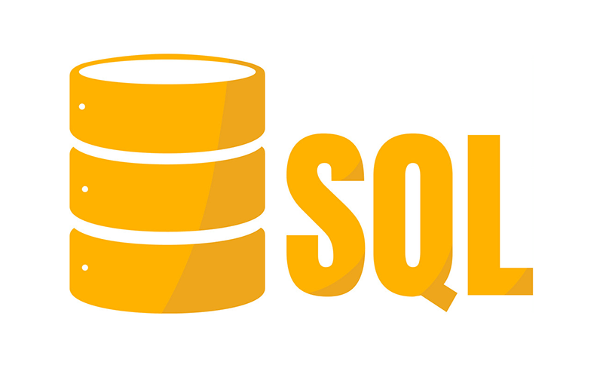

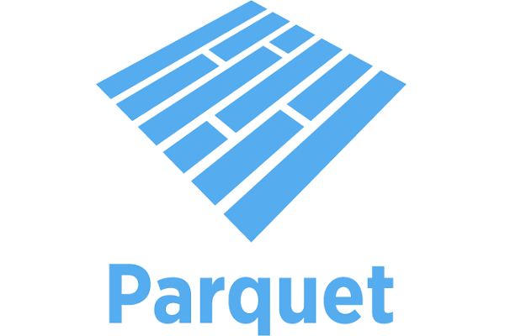


Apache Spark
programming languages…
plays well with…
file formats…
even it is easy to work with
unstructured data…
…images and sound files

Slide 24
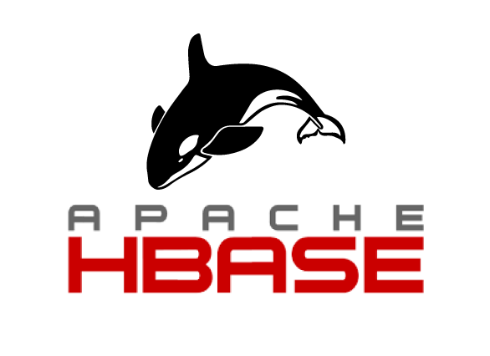
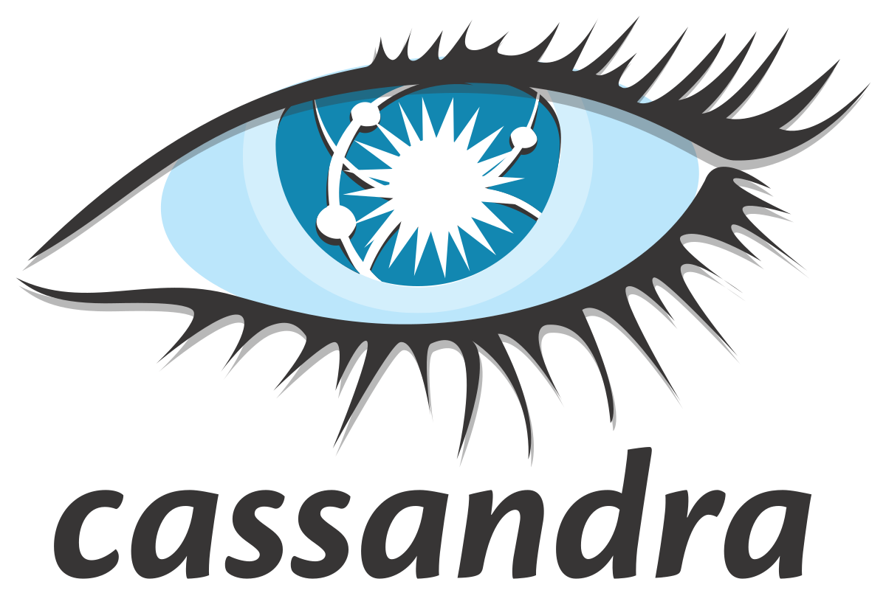
Apache Tools

Slide 25
Databricks: Managed Spark
…is Apache Spark packaged into a cloud service
…removes all the techy parts for getting started
…is cloud optimized (good at scaling up and down)
…UI is built for collaboration and co-development
…can connect to other tools (e.g., MS Power BI)

